Slide 1
CS 310 Operating Systems Lecture 4: Process – Multiprogramming, Multiprocessing, Boot Sequence
Ravi Mittal
IIT Goa

Slide 2
Acknowledgements !
Contents of this class presentation has been taken from various sources. Thanks are due to the original content creators:
Class presentation: University of California, Berkeley: David Culler, Anthony D. Joseph, John Kubiatowicz, AJ Shankar, George Necula, Alex Aiken, Eric Brewer, Ras Bodik, Ion Stoica, Doug Tygar, and David Wagner.
Operating Systems: Principles and Practice (2nd Edition) Anderson and Dahlin
Volume 1, Kernel and Processes
Chapter 2

Slide 3
Use the following for your learning..
Operating Systems: Principles and Practice (2nd Edition) Anderson and Dahlin
Volume 1, Kernel and Processes
Chapter 2
https://inst.eecs.berkeley.edu/~cs162/su21/
CS 162, UCB
https://youtu.be/itfEcA3TXq4

Slide 4
We will study..
Multiprogramming, context switching, Multiprocessing
Process – Creation

Slide 5
Concepts we learnt so far

Slide 6
Four Fundamental OS Concepts
Process: an instance of a running program
Protected Address Space + One or more Threads
Address space
Set of memory addresses accessible to program (for read or write)
Thread: Execution Context
Fully describes program state
Dual mode operation / Protection
User / Kernel mode
Kubiatowicz CS162 © UCB Spring 2021

Slide 7
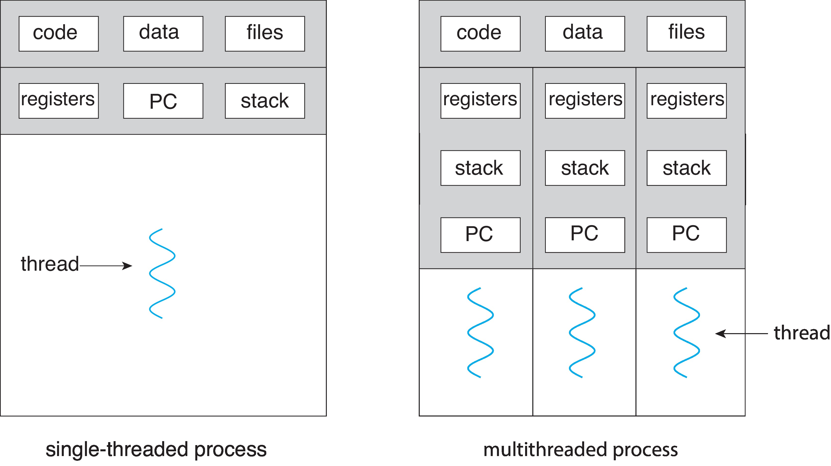
Single and Multithreaded Processes
Threads encapsulate concurrency: “Active” component
Address spaces encapsulate protection
Threads share memory; In processes – sharing memory is complex
Operating Systems Principles and Practice: Anderson and Dahlin

Slide 8
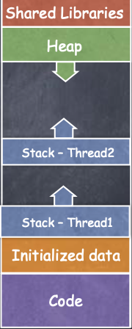
Thread
Process Address Space
All threads within a process share
Heap
Global/static data
Libraries
Each thread has a separate
Program Counter
Stack
Registers
Note two threads of the same process
Kubiatowicz CS162 © UCB Spring 2021

Slide 9
User/Kernel (Privileged) Mode
User Mode
interrupt
exception
syscall
rtn
rfi
Kernel Mode
exit
exec
Limited HW access
Full HW access
Kubiatowicz CS162 © UCB Spring 2021

Slide 10
Multiprogramming, Context Switching, and Multiprocessing

Slide 11
Multiprogramming
On a modern computer, there are hundreds of different processes running simultaneously -- but only a few CPUs
In the period of microseconds, the OS rapidly switches between all processes to allow each process to run on a CPU
In the multi-programming system, one or multiple programs can be loaded into its main memory for execution
When the OS swaps out one process from one CPU and allows a new process to run, this is called a context switching
Kubiatowicz CS162 © UCB Spring 2021

Slide 12
Multiprogramming
Physical Memory
Proc 1
Proc 2
Proc n
stack
…
heap
Static Data
OS
code
stack
heap
Static Data
code
OS timeshares CPU across multiple
Processes
stack
heap
Static Data
code
Kubiatowicz CS162 © UCB Spring 2021

Slide 13
Illusion of Multiple Processors
vCPU1
vCPU2
vCPU3
vCPU1
vCPU2
vCPU3
vCPU1
vCPU2
Shared Memory
Time
Assume a single processor (core). How do we provide the illusion of multiple processors?
Multiplex in time!
Threads/processes are virtual cores
Contents of virtual core (thread/process):
Entire address space: Process
Program counter, stack pointer, Registers : Thread
Where is “it” (the process / thread)?
On the real (physical) core, or
Saved in chunk of memory – PCB or TCB
Adapted from: Kubiatowicz CS162 © UCB Spring 2021

Slide 14
Illusion of Multiple Processors (Continued)
vCPU1
vCPU2
vCPU3
T1
T2
vCPU1
vCPU2
vCPU3
vCPU1
vCPU2
Shared Memory
Time
Consider:
At T1: vCPU1 on real core, vCPU2 in memory
At T2: vCPU2 on real core, vCPU1 in memory
What happened?
OS ran, triggering context switch
Saved state in control block (for Process PCB ; For Thread: TCB)
Loaded PC, SP, … from vCPU2’s processor block, jumped to PC
What triggered this switch?
Timer, voluntary yield, I/O, other things
OS has a CPU scheduler that picks up on of the process/thread
Policy: Which Process
Mechanism: How to context switch
Adapted from Kubiatowicz CS162 © UCB Spring 2021

Slide 15
What is required during context switching?
CPU
Save all CPU registers
Caches
Save all CPU caches specific to the process
Page Table
Page tables are unique to each process
Switch to the new page table (for the process to be executed)
Overall Cost
Expensive
OS must minimize time for context switching
A lot of progress is made in the few decades
Still it is a few microseconds
Kubiatowicz CS162 © UCB Spring 2021

Slide 16
Multiprocessing vs. Multiprogramming
Multiprocessing: Multiple CPUs(cores)
Multiprogramming: Multiple jobs or multiple processes
Multithreading: Multiple threads per process
A
B
C
Multiprogramming
A
B
C
A
B
C
B
A
Multiprocessing
B
C
Kubiatowicz CS162 © UCB Spring 2021

Slide 17
Concurrency is not Parallelism
Concurrency is about handling multiple things at once
Parallelism is about doing multiple things simultaneously
Example: Two threads on a single-core system...
… execute concurrently …
… but not in parallel
Parallel => concurrent, but not the other way round!
Kubiatowicz CS162 © UCB Spring 2021

Slide 18
Process - Basics

Slide 19
The Process abstraction (Repeat)
Operating Systems Principles and Practice: Anderson and Dahlin

Slide 20
The Process Abstraction
Compiler
converts the code into machine instructions and stores them into a file – executable image
Also defines any static data that the program needs along with its initial values – include them in the executable image
To Run the program
OS copies the instructions and data from the executable image into physical memory
OS also sets aside a memory region for execution stack – that hold local variables during execution and a memory region called heap - to hold any dynamically allocated data structures
Note that the OS must already be in the memory so that it can copy executable file into the memory
With its own stack and heap
Operating Systems Principles and Practice: Anderson and Dahlin

Slide 21
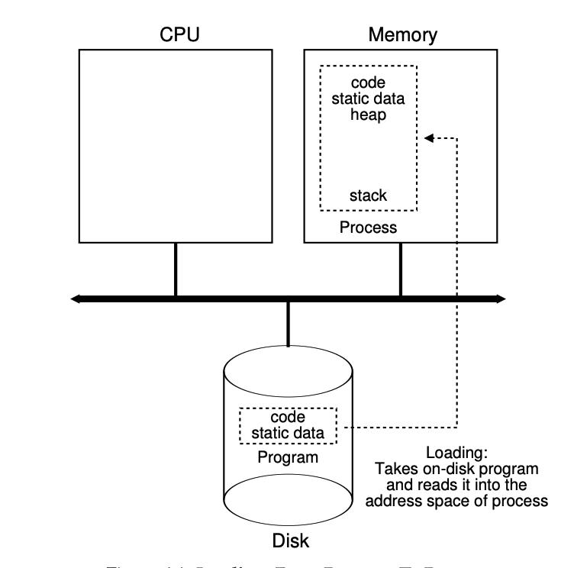
Process Creation
OS allocates memory and creates memory image
Loads code, static data from disk executable (eg a.out)
Creates and initialized runtime stack
Create heap
Opens basic files
Standard Input, Output, Error
Standard Input Output let programs read input from terminal and print output to screen
Initializes CPU registers
PC points to first instruction
Operating Systems Principles and Practice: Anderson and Dahlin

Slide 22
Kernel code/data in process Virtual Address Space?
Process image
Unix: Kernel space is mapped in high - but inaccessible to user processes

Slide 23
When you switch on computer – fresh start
When you press power button
RAM is empty
It does not contain OS
OS is in disk in the beginning
Goals of a computer at boot
Ensure a minimal set of hardware is functional
CPU, Screen, Hard Disk, Keyboard
Hand control over to the OS
Let OS handle remaining operations
Operating Systems Principles and Practice: Anderson and Dahlin

Slide 24
Boot Sequence (1)
Set PC to start execution at ta pre-determined position in memory
System uses a special read-only hardware memory (Boot ROM)
Boot ROM stores boot instructions
On x86, the boot program is called BIOS: Basic Input/Output System
ROM instructions are fixed at the time of manufacturing (computer) ; they are never changed
Hence, it is not good to keep entire OS in the ROM
OS needs frequent updates for bugs and security fixes
ROM storage is slow and expensive
So, small amount of code is kept in BIOS in ROM
Operating Systems Principles and Practice: Anderson and Dahlin

Slide 25
Booting Sequence (2)
Operating Systems Principles and Practice: Anderson and Dahlin

Slide 26
Boot Sequence (3)
The BIOS reads a fixed-size block from a fixed position on disk (or SSD) into memory
This block is called bootloader
Once the bootloader is copied to memory
It jumps to the first instruction of the bootloader
Bootloader in turn loads the kernel into memory
(Note that Kernel’s executable image is usually stored in the file system (on disk))
The bootloader jumps to the Kernel
Note that
BIOS just reads a block of raw data from disk
Bootloader, in turn, needs to know how to read kernel image (as a file) in the file system
Operating Systems Principles and Practice: Anderson and Dahlin

Slide 27
Boot Sequence (4)
Kernel initializes data structures
Setting up Interrupt vector table
To point to various interrupts, processor exceptions, sys call handler
Kernel starts the first process – typically the user login page
OS reads login program code from it’s disk location and jumps to the first location of the program
Operating Systems Principles and Practice: Anderson and Dahlin

Slide 28
Lecture Summary
In the multi-programming system, one or multiple programs can be loaded into its main memory for execution
Multiprocessing – multiple jobs parallelly running
Multithreading – Multiple threads per process
Starting computer system involves
Pointing PC to fixed location in Boot ROM
Boot ROM loads Bootloader image from disk into memory
Bootloader, in turn, loads OS Kernel image from hard disk to memory
OS kernel starts running
A process has following states: New, Waiting, Ready, Running, and Terminated – will study in the next class

